Slide 1
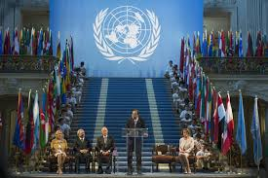
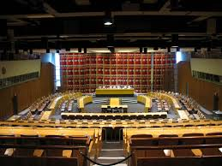
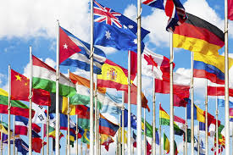
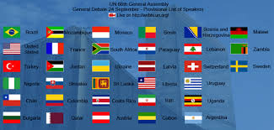
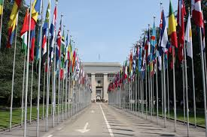
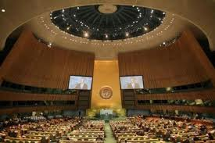
UN Model

Slide 2
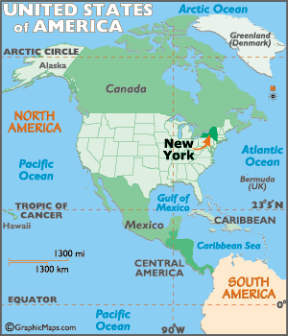
Where is the headquarters of the UN Organization situated?
The Headquarters of the United Nations is a complex in New York City. The complex has served as the official headquarters of the United Nations since its completion in 1952. It is located in the Turtle Bay neighborhood of Manhattan, on spacious grounds overlooking the East River.

Slide 3
What are the goals of the UN Organization?
The United Nations Charter's goals to employ international machinery for the promotion of the economic and social advancement of all peoples and to promote higher standards of living, full employment and conditions of economic and social progress and development remain fully valid but under circumstances that have changed profoundly.

Slide 4
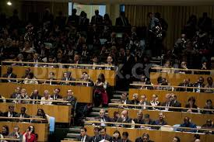
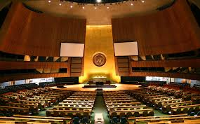
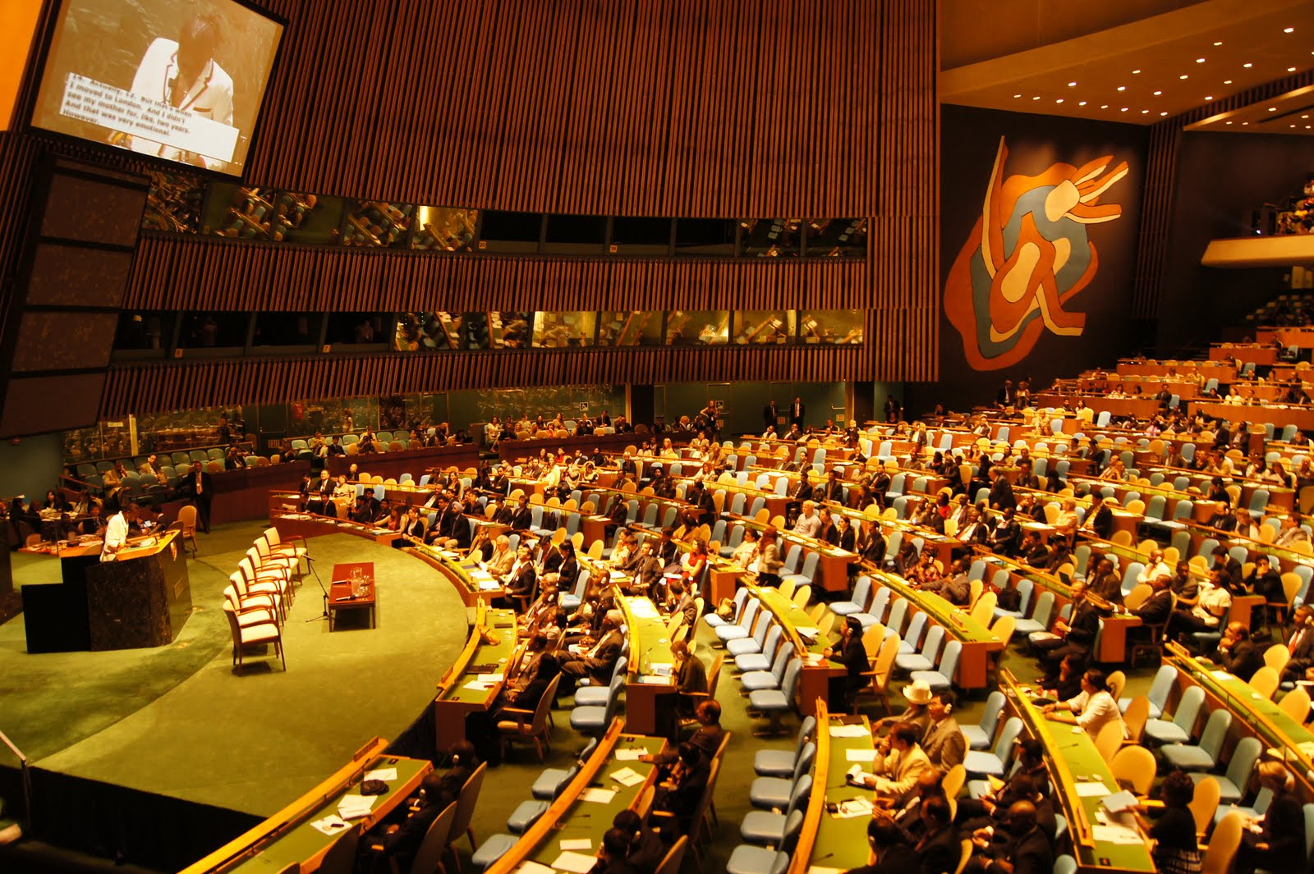
How many organs does the UN Organization include?
There are 6 main organs.
Economic and Social Council
General Assembly
Security Council
Trusteeship Council
Secretariat
International Court of Justice

Slide 5
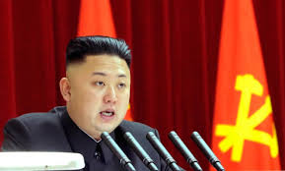
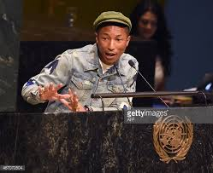
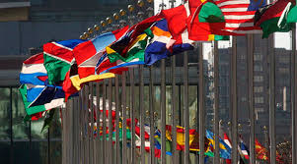
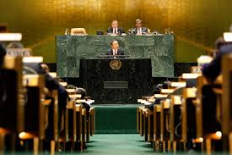
Do the UN use solely peaceful ways to achieve their aims?
They don’t always debate peacefully sometimes they have to raise their voice but not dramatically because they do it like real adults like they say.

Slide 6
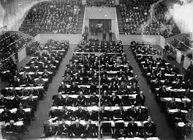
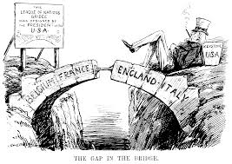
What organization existed before the un?
The forerunner of the United Nations was the League of Nations, an organization conceived in similar circumstances during the first World War, and established in 1919 under the Treaty of Versailles "to promote international cooperation and to achieve peace and security."

Slide 7
Why was the league of nations stopped?
Italy left the League in 1937. Few other countries left the League, but all of them realized that it had failed - instead they began to re-arm as fast as possible.
During 1938, Britain and France tried a new policy - 'appeasement' (negotiating directly with Hitler); this failed in 1939 when Hitler invaded Czechoslovakia.
When war broke out in 1939, the League closed down; its headquarters in Geneva remained empty throughout the war.
In 1943 - at a Conference in Tehran - America, Britain and Russia agreed to set up a new international organization (the 'United Nations') when the war finished.
On 12 April 1946, the League met in Geneva and formally abolished itself. The British delegate, Robert Cecil, said: 'The League is dead. Long live the United Nations'.

Slide 8
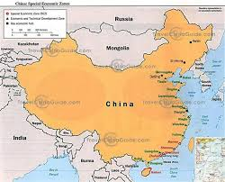
Is China a member of the UN?
China is a charter member of the United Nations and one of five permanent members of the United Nations Security Council after being on the winning side following the Second World War. The Republic of China(ROC) joined the UN in 1945.

Slide 9
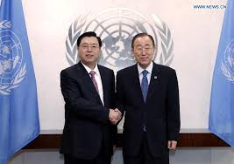
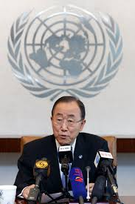
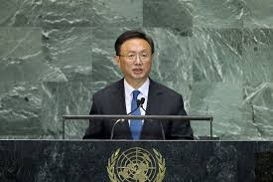
Can you give any additional information on China’s role as a UN member?
China is a charter member of the United Nations and one of five permanent members of the United Nations Security Council after being on the winning side following the Second World War.

Slide 10
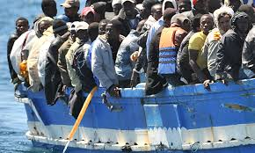
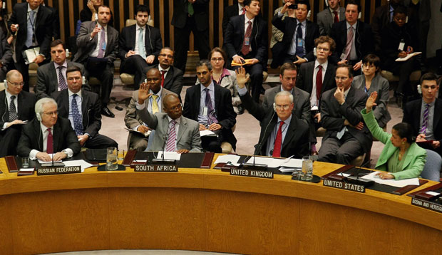
If you were an ambassador, which country would you represent?
I would represent the United Kingdom. The United Kingdom is a founding member of the United Nations and one of five permanent members of the Un Security Council. I would try to stop immigrants coming into the country due to recent terrorist arttacks.

