Slide 1
United nations
By erin birch <3

Slide 2
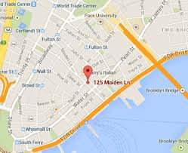
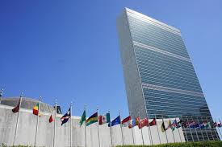
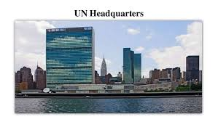
Where is the headquarters of the UN Organization situated?
The UN is placed in New York. It has been here since 1952, It is located in the Turtle Bay neighborhood of Manhattan, on spacious grounds overlooking the East River .

Slide 3
What are the goals of the UN Organization?
The goals of the united nations is to keep the peace between different countries and to make rules to make the world a better place.

Slide 4
How many organs does the UN Organization include?
The main organs of the UN are the General Assembly, the Security Council, the Economic and Social Council, the Trusteeship Council, the International Court of Justice, and the UN Secretariat.

Slide 5
Do the UN use peaceful ways to obtain their aims?
Many people are still debating over this argument as some people believe the UN start up conflict whilst many still believe they solve conflict by supporting immigration etc…

Slide 6
What organisation was before the UN?
This was the league of nations and it was founded in the 1919.

