Slide 1
United Nations
By Emily Dentith

Slide 2
Introduction
The United Nations has four purposes: to maintain international peace and security; to develop friendly relations among nations; to cooperate in solving international problems and in promoting respect for human rights; and to be a Centre for harmonizing the actions of nations. Cooperating in this effort are more than 30 affiliated organizations, known together as the UN system.
The United Nations is not a world government, and it does not make laws. It does, however, provide the means to help resolve international conflicts and formulate policies on matters affecting all of us.

Slide 3
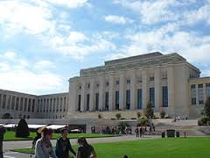
Where is the headquarters of the UN Organization situated?
Four of the five principal organs are located at the main UN Headquarters in New York City. The International Court of Justice is located in The Hague, while other major agencies are based in the UN offices at Geneva, Vienna, and Nairobi. Other UN institutions are located throughout the world.

Slide 4
What are the goals of the UN Organization?
The Millennium Development Goals (MDGs) are a set of eight measurable goals signed by 189 countries in September 2000 demonstrating their commitment to achieve these goals, ranging from ending poverty and hunger to promoting gender equality and child health by 2015.
According to UNESCO’s 2015 Global Monitoring Report, Education For All 2000-2015: Achievements and Challenges, there are still 58 million children of out of school globally. Of these children, 25 million are in the rural, low-income, post-conflict regions that UWS targets. These children are some of the poorest in the world, meaning they are four times less likely to attend school than children in the richest nations.

Slide 5
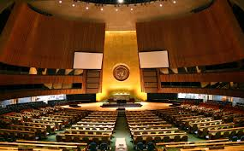
How many organs does the UN Organization include?
The main organs of the UN are the General Assembly, the Security Council, the Economic and Social Council, the Trusteeship Council, the International Court of Justice, and the UN Secretariat. All were established in 1945 when the UN was founded.

Slide 6
Do the UN use solely (=only) peaceful ways to achieve their aims?
They perform life-saving work delivering essential aid all around the world. However they also have longer-term projects and strategies aimed at building the capacity of both the population and the state.

Slide 7
What organization was prior to (=existed before) the UN?

