Slide 1
United Nations
By Mia Morana

Slide 2
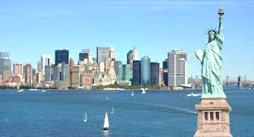
Where is the headquarters of the UN Organization situated?
Four of the five principal organs are located at the main UN Headquarters in New York City. The International Court of Justice is located in The Hague, while other major agencies are based in the UN offices at Geneva, Vienna, and Nairobi. Other UN institutions are located throughout the world.

Slide 3
What are the goals of the UN Organization?
The Eight Millennium Development Goals are:
to eradicate extreme poverty and hunger
to achieve universal primary education
to promote gender equality and empower women
to reduce child mortality
to improve maternal health
to combat HIV/AIDS, malaria, and other diseases
to ensure environmental sustainability and to develop a global partnership for development.

Slide 4
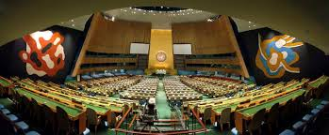
How many organs does the UN Organization include?
The General Assembly:
The General Assembly is the main deliberative organ of the United Nations and includes all its Members. It may discuss any matter arising under the UN Charter and make recommendations to UN Members (except on disputes or situations which are being considered by the Security Council). In the Assembly, each nation, large or small, has one vote and important decisions are taken by a two-thirds majority voteThe Assembly meets every year from September to December. Special sessions may be summoned by the Assembly, at the request of the Security Council, or at the request of a majority of UN Members.The work of the General Assembly is also carried out by its six main committees, the Human Rights Council, other subsidiary bodies and the UN Secretariat.
The Security Council:
The Security Council has primary responsibility under the Charter for maintaining peace and security. It can be convened at any time, whenever peace is threatened Member States are obligated to carry out its decisions. When a threat to peace is brought before the Council, it usually first asks the parties to reach agreement by peaceful means. If fighting breaks out, the Council tries to secure a ceasefire.
The Economic and Social Council:
The Economic and Social Council (ECOSOC) is the central body for coordinating the economic and social work of the United Nations and the UN family of organizations. It has 54 member nations elected from all regions. As much as 70 per cent of the work of the UN system is devoted to promoting higher standards of living, full employment, and conditions of economic and social progress and development. The Council recommends and directs activities aimed at promoting economic growth of developing countries, supporting human rights and fostering world cooperation to fight poverty and under-development.
The Trusteeship Council:
The Trusteeship Council was assigned under the UN Charter to supervise the administration of Trust Territories — former colonies or dependent territories — which were placed under the International Trusteeship System.
The International Court of Justice:
The International Court of Justice (ICJ) is the UN’s main judicial organ. Presiding over the ICJ, or “World Court”, are 15 judges, each from a different nation, elected by the General Assembly and Security Council. The Court settles legal disputes between nations only and not between individuals, in accordance with international law.
The Secretariat:
The Secretariat is made up of an international staff working at UN Headquarters in New York, as well as UN offices in Geneva, Vienna, Nairobi and other locations. It consists of departments and offices with a total staff of around 16,000, drawn from some 175 countries. Including civil staff in peacekeeping missions the total number comprises approximately 30,000 staff. Staff members carry out the substantive and administrative work of the United Nations as directed by the General Assembly, the Security Council and the other organs.

Slide 5
Do the UN use solely peaceful ways to achieve their aims?
The title “how does the UN keep the peace” is rather a broad one, given that
avoiding the scourge of war was of course the main aim of the UN’s foundation. I’m
of the opinion that all three pillars of the UN contribute towards both preventing
conflict from breaking out and working in post-conflict states. This holistic approach
can be broadly categorized as capacity-building, state-building and
peacebuilding. Time is short so rather than keep you here all night I hope to give you
just a few examples of this area of the UN’s work. Later David will be going into what
happens when this doesn’t go to plan!

Slide 6
What organization was prior to the UN?
The League of Nations, 1920:
The League of Nations was an international organization, headquartered in Geneva, Switzerland, created after the First World War to provide a forum for resolving international disputes. Though first proposed by President Woodrow Wilson as part of his Fourteen Points plan for an equitable peace in Europe, the United States never became a member.

Slide 7
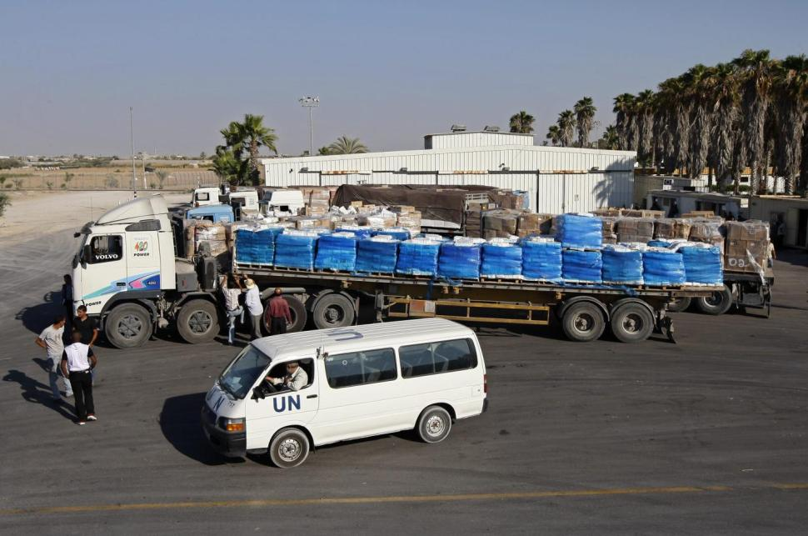
Why was this organization dismissed?
UNITED NATIONS —
Four U.N. staff members were dismissed for sending and storing child pornography on U.N. computers and another was dismissed for using a U.N. vehicle to transport approximately 173 kilograms of marijuana, according to a U.N. report obtained Friday.
The report on U.N. disciplinary matters and cases of criminal behavior, covers a year-long period through June 2015, and documents about 60 cases that resulted in disciplinary measures, among the organization’s worldwide staff of about 40,000.
The report, circulated late last month, states that during the year-long period eight cases involving “credible allegations of criminal conduct by United Nations officials or experts on mission were referred to member states.”

Slide 8
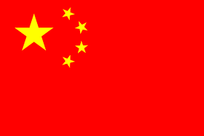
Is China a member of the UN?
China is a charter member of the United Nations and one of five permanent members of the United Nations Security Council after being on the winning side following the Second World War. The Republic of China (ROC) joined the UN in 1945.

Slide 9
Can you give any additional information on China’s role as a UN member?
In recent years, China has taken an active role in UN peacekeeping operations based
on its evaluation of its national interest and its role as a responsible global power. Yet
a major Chinese concern is the erosion of basic peacekeeping principles in practice.
China favors a modest reform of the Security Council. While recognizing the need
for reform, it firmly advocates a thoroughgoing consultation and consensus-building
process. China regards the concert of permanent members in the Council based on
veto rights as a stabilizing mechanism for the international system.

