Slide 1
acquiescence
/ˌakwɪˈɛsns/
the reluctant acceptance of something without protest.
"in silent acquiescence, she rose to her feet"
Similar:
consent
agreement
acceptance
accession
concurrence

Slide 2
Portmanteau
noun
noun: portmanteau;
a large travelling bag, typically made of stiff leather and opening into two equal parts.
a word blending the sounds and combining the meanings of two others, for example motel or brunch.
"podcast is a portmanteau, a made-up word coined from a combination of the words iPod and broadcast“
3.consisting of or combining two or more aspects or qualities.
"a portmanteau movie composed of excerpts from his most famous films"

Slide 3
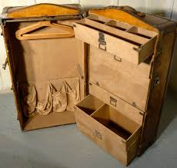
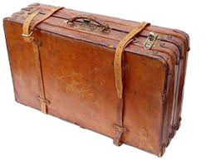
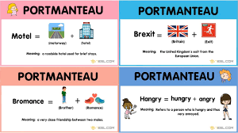

Slide 4
ominous
/ˈɒmɪnəs/
adjective
giving the worrying impression that something bad is going to happen; threateningly inauspicious.
"there were ominous dark clouds gathering overhead"
Similar:
threatening
menacing
baleful
forbidding
sinister
doomy
inauspicious

Slide 5
biting
/ˈbʌɪtɪŋ/
adjective
1.
(of insects and certain other animals) able to wound the skin with a sting or fangs.
"a cream to ward off biting insects"
2.
(of wind or cold) so cold as to be painful.
"he leant forward to protect himself against the biting wind"
Similar:
bitterly cold
freezing
icy-cold
arctic
glacial
frigid
frosty

Slide 6
fling
/flɪŋ/
verb
past tense: flung; past participle: flung
1.throw or hurl forcefully.
"he picked up the debris and flung it away"
Similar:
throw
toss
sling
hurl
cast
pitch
lob
bowl
launch
flip
shy
send
propel
project
aim
direct
catapult
fire
send flying
let fly with
chuck
heave
bung
buzz
whang
yeet
peg
hoy
bish
2.move or push (something) suddenly or violently.
"he flung back the bedclothes"
start or engage in (an activity or enterprise) with great energy and enthusiasm.
"he flung himself into his athletics"

Slide 7
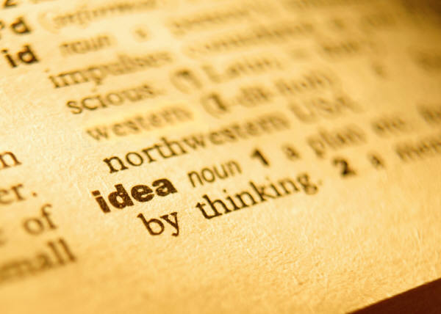
Modals Verbs & Modifiers…
Useful modals and modifiers for discussing and analysing language and literature

Slide 8
Modal Verbs | Modifiers
Can Could May Might Must Shall Should Will Would | Almost Certainly Clearly Definitely Effectively Emphatically Essentially Evidently Immediately In effect In fact In a sense | Necessarily Often Perhaps Possibly Probably Somewhat Ultimately Undoubtedly Unquestionably

Slide 9
Common conjunctive adverbs
Accordingly Additionally Again Almost Anyway As a result Besides Certainly Comparatively Consequently Contrarily Conversely Elsewhere Equally | Eventually Finally Further Furthermore Hence Henceforth However In addition In comparison In contrast In fact Incidentally Indeed Instead | Just as Likewise Meanwhile Moreover Namely Nevertheless Next Nonetheless Notably Now Otherwise Rather Similarly Still | Subsequently That is Then Thereafter Therefore Thus Undoubtedly Uniquely On the other hand

Slide 10
Verbs for Analysis…

Slide 11
Note of Caution: Only use the verbs you’re familiar with unless you take the time to examine the definition in the dictionary. This is not a list of synonyms. Each word has specific uses that are unique to its meaning.
L1
Argues
Builds
Confirms
Conveys
Connects
Creates
Describes
Demonstrates
Displays
Establishes
Exaggerates
Explains
Explores
Exposes
Highlights
Hints
Illustrates
Implies
Indicates
Informs
Introduces
Means
Narrates
Persuades
Portrays
Presents
Refers
Represents
Reveals
Sees
Shows
Signifies
Symbolises
Suggests
Supports
Tells
Understands

Slide 12
Note of Caution: Only use the verbs you’re familiar with unless you take the time to examine the definition in the dictionary. This is not a list of synonyms. Each word has specific uses that are unique to its meaning.
L2
Advises
Affects
Argues
Builds
Confirms
Connects
Connotes
Conveys
Creates
Criticises
Deepens
Denotes
Depicts
Describes
Demonstrates
Displays
Echoes
Emphasises
Encourages
Establishes
Evokes
Exaggerates
Examines
Expands
Explains
Explores
Exposes
Expresses
Forces
Forms
Highlights
Heightens
Hints
Illustrates
Impacts
Implies
Indicates
Informs
Introduces
Juxtaposes
Means
Mentions
Narrates
Perceives
Persuades
Portrays
Presents
Recognises
Refers
Relates
Remarks
Represents
Reveals
Sees
Shows
Signifies
Symbolises
Suggests
Supports
Tells
Underlines
Understands

Slide 13
Note of Caution: Only use the verbs you’re familiar with unless you take the time to examine the definition in the dictionary. This is not a list of synonyms. Each word has specific uses that are unique to its meaning.
L3
Advises
Affects
Argues
Articulates
Builds
Clarifies
Confirms
Connects
Connotes
Considers
Constructs
Contradicts
Conveys
Creates
Criticises
Deepens
Denotes
Depicts
Describes
Demonstrates
Displays
Echoes
Emphasises
Encourages
Establishes
Evokes
Exaggerates
Examines
Exhibits
Expands
Explains
Explores
Exposes
Expresses
Foreshadows
Forces
Forms
Highlights
Heightens
Hints
Illustrates
Impacts
Implies
Indicates
Informs
Intensifies
Introduces
Juxtaposes
Means
Mentions
Narrates
Perceives
Persuades
Portrays
Presents
Promotes
Recognises
Refers
Reinforces
Relates
Remarks
Represents
Reveals
Sees
Shows
Signifies
Symbolises
Suggests
Supports
Tells
Underlines
Understands

Slide 14
Note of Caution: Only use the verbs you’re familiar with unless you take the time to examine the definition in the dictionary. This is not a list of synonyms. Each word has specific uses that are unique to its meaning.
Key Stage 4&5: Active verbs for writing about texts...
Accentuates
Advises
Advocates
Affects
Alludes to
Amplifies
Argues
Articulates
Builds
Clarifies
Compels
Confirms
Connects
Connotes
Considers
Constructs
Contradicts
Compels
Compounds
Conveys
Creates
Criticises
Deepens
Denotes
Depicts
Describes
Determines
Demonstrates
Displays
Echoes
Elaborates
Elicits
Embodies
Emphasises
Encapsulates
Encourages
Establishes
Evokes
Exaggerates
Examines
Exemplifies
Exhibits
Expands
Explains
Explores
Exposes
Expresses
Forces
Foregrounds
Foreshadows
Foretells
Forms
Highlights
Heightens
Hints
Illustrates
Impacts
Implies
Indicates
Informs
Intensifies
Introduces
Invokes
Juxtaposes
Manifests
Means
Mentions
Narrates
Perceives
Personifies
Persuades
Pervades
Portrays
Presents
Promotes
Recognises
Refers
Reinforces
Reiterates
Relates
Remarks
Represents
Reveals
Sees
Shows
Signifies
Symbolises
Stresses
Subverts
Suggests
Supports
Tells
Typifies
Underlines
Undermines
Underpins
Understands

Slide 15
(Some) more unusual verbs for analysis…
Verb / Noun / Adjective
Definition

Slide 16
Alludes to / Allusion To hint at or reference; to mention indirectly
“With its tightly curled letters and Shakespearean allusions, a new mural unveiled at a Leeds academy this week provides an elegant backdrop for learning.”
“The protagonist’s speech alludes to the catastrophic events which happen later in the novel.”
“The writer alludes to Greek myths.”

Slide 17
Amplifies / Amplification To make larger or more powerful; to increase or exaggerate
“In some scenes, dialogue is interspersed with pauses and long silences, and this amplifies the tense, fraught atmosphere that exists between these characters.”
“The sense of terror is amplified when innocuous objects are described using fearsome metonymic words.”
“Social media is increasingly becoming the most effective way of amplifying a message.”

Slide 18
Compels / Compelling (adj) To exert a strong, irresistible force on someone
“The headline’s shocking statistic compels the reader to pay attention and read on.”
“The intensity of the lead singer was ‘utterly compelling’, according to one member of the audience.”
“The energy crisis compelled a national decrease in fuel consumption.”

Slide 19
Evokes / Evocation
To bring or recall (a feeling, memory, or image) to the mind
“As the character delivers her sad lament, sympathy is evoked in the reader.”
“A horned owl hoot-hooted up the hill from the tent, a sound comforting in its evocation of her California mountains.”
“The poet’s repetition of ‘rage, rage against the dying of the light’ evokes a sense frustration and grief.”

Slide 20
Juxtaposes / Juxtaposition
Contrasting things put together for emphasis
“The Prime Minister’s speech about austerity at the Lord Mayor’s Banquet was delivered at a gold lectern – an uncomfortable juxtaposition for some.”
“The juxtaposition of scenes in Shakespeare’s play As You Like It serves to subtly contrast and compare characters and situations.”
“Black-and-white photos of slums were starkly juxtaposed with colour images.”

Slide 21
Manifests / Manifestation
To be clear; to make clear in a visible or understandable way
“He argued that crime and deviant behaviour is largely a manifestation of poverty and social inequality.”
“The ill-treatment Edmund has suffered at the hands of his father and the society he has grown up in ultimately manifests itself in his heartless actions.”
“The truth is we don't to what degree genetics manifests itself in intelligence.”

Slide 22
Reiterates / Reiteration
To say something again for emphasis or clarity
“The writer reiterates his argument in the final paragraph of the piece to ensure that it is clearly conveyed to the reader.”
“Sergio Garcia reiterates his desire to apologise in person to Tiger Woods after race row.”
“The final speech of the play serves as a reiteration of its central message.”

Slide 23
Typifies / Typical (adj) To serve as a typical example of something
“Such an impressive display of man against nature typifies the spirit of the tribe.”
“The girls’ fearful reaction to Abigail’s outburst typifies the power she holds over the young women in her community.”
“Antagonism towards women typifies our aggressive society.”

