Slide 1
TEMAS DE ESPAÑOL
Theme 1: Identity and culture
Topic 1: Me, my family and friends | Topic 2: Technology in everyday life | Topic 3: Free-time activities | Topic 4: Customs and festivals in Spanish-speaking countries/communities
Relationships with family and friends Marriage/partnership | Social media Mobile technology | Music Cinema and TV Food and eating out Sport
Theme 2: Local, national, international and global areas of interest
Topic 1: Home, town, neighbourhood and region | Topic 2: Social issues | Topic 3: Global issues | Topic 4: Travel and tourism
 | Charity/voluntary work Healthy/unhealthy living | The environment Poverty/homelessness
Theme 3: Current and future study and employment
Topic 1: My studies | Topic 2: Life at school/college | Topic 3: Education post-16 | Topic 4: Jobs, career choices and ambitions

Slide 2
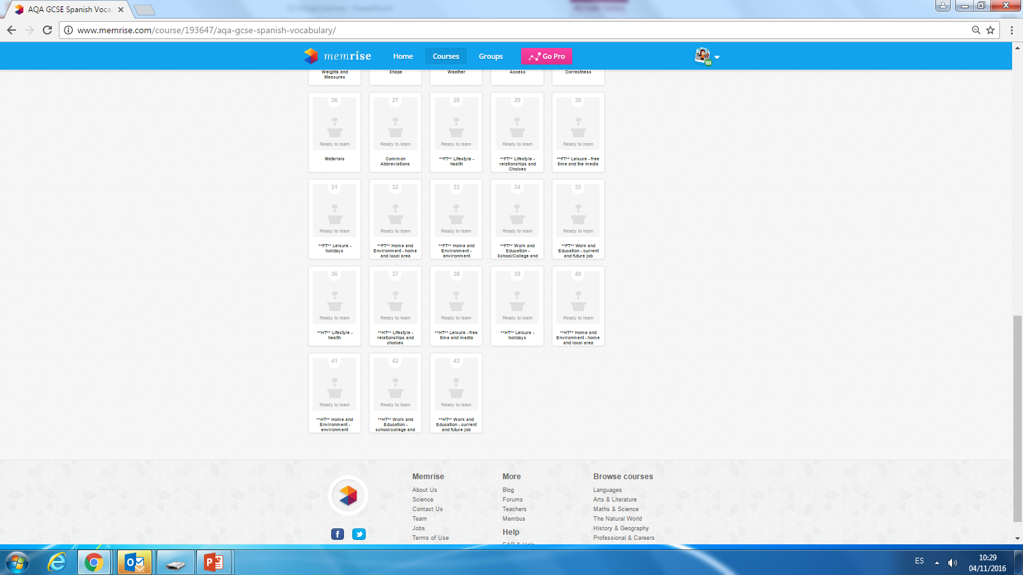
Topics to revise from memrise
As well as the basic vocabulary
from number 11 to 21

