Slide 1
GCSE Spanish Revision
el once de abril

Slide 2
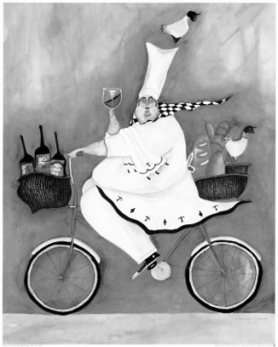
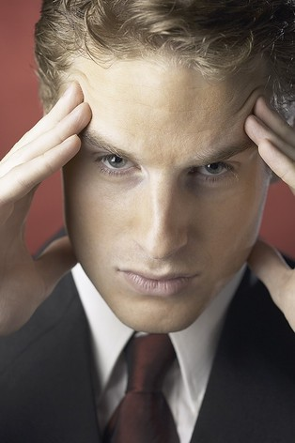

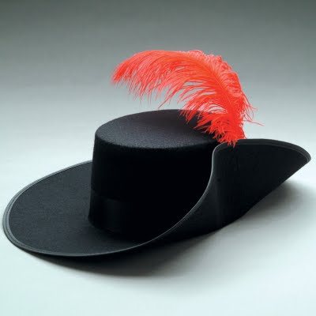

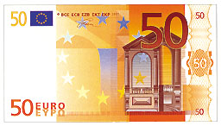

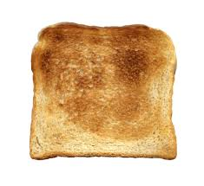

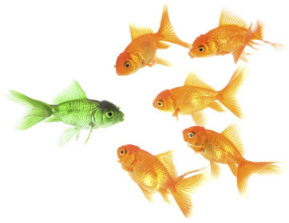
1 | 2 | 3 | 4
10 | TEN GOOD REASONS TO KNOW A FOREIGN LANGUAGE |  | 5
9 | 8 | 7 | 6
Notes:
1. Communicator 2. can learn new things – just like riding a bike 3. can concentrate and focus 4. another feather in my cap 5. spots mistakes/proof reader 6. problem solver 7. quick thinker 8. culture aware 9. learn another language 10. employability

Slide 3
What are the four main topic areas for revision?

Slide 4
What are the four main topic areas for revision?
LIFESTYLE
LEISURE
HOME AND ENVIRONMENT
EDUCATION

Slide 5
What are the 9 subtopics?
LIFESTYLE
LEISURE
HOME AND ENVIRONMENT
EDUCATION

Slide 6
What are the 9 subtopics?
Food and Drink
Relationship and Choices
Free Time and the Media
School/college and future plans
Home and Local Area
Holidays
Environment
Current and Future Jobs
Health

Slide 7
What are the 9 subtopics?
LIFESTYLE | Health | Food and Drink | Relationship and Choices
LEISURE
HOME AND ENVIRONMENT
EDUCATION

Slide 8
What are the 9 subtopics?
LIFESTYLE | Health | Food and Drink | Relationship and Choices
LEISURE | Free Time and the Media | Holidays
HOME AND ENVIRONMENT
EDUCATION

Slide 9
What are the 9 subtopics?
LIFESTYLE | Health | Food and Drink | Relationship and Choices
LEISURE | Free Time and the Media | Holidays
HOME AND ENVIRONMENT | Home and Local Area | Environment
EDUCATION

Slide 10
What are the 9 subtopics?
LIFESTYLE | Health | Food and Drink | Relationship and Choices
LEISURE | Free Time and the Media | Holidays
HOME AND ENVIRONMENT | Home and Local Area | Environment
EDUCATION | School/college and future plans | Current and Future Jobs

Slide 11
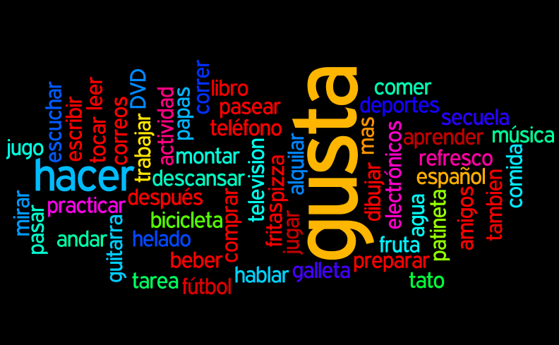
TOP 3 TIPS
REVISE and LEARN vocabulary
SHORT and REGULAR language practice
UNPICK the exam questions

Slide 12

IT’S ALL ABOUT VOCABULARY

Slide 13
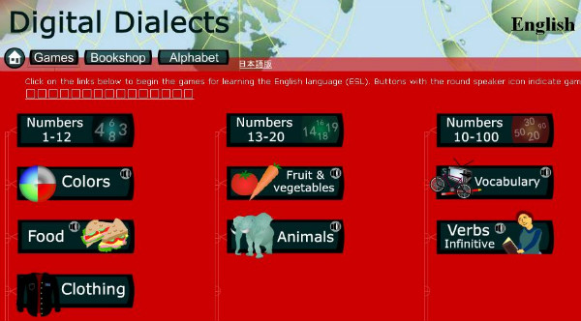
Vocabulary
http://www.digitaldialects.com/Spanish.htm
Vocabulary Builders 1 and 2

Slide 14

KNOW THE BASICS

Slide 15
KNOW THE BASICS
Days of the Week
Months
Numbers
The Time
Time phrases
Opinions
Greetings

Slide 16
Phrases and Greetings
http://www.digitaldialects.com/Spanish.htm
Phrases and Greetings 1 and 2
Audio

Slide 17
Days and Months
http://www.digitaldialects.com/Spanish/Daysmonths.htm

Slide 18
Numbers
DEVISE a double page revision aid on numbers!

Slide 19
The Time
http://www.studyspanish.com/lessons/time.htm

Slide 20
Time phrases
ahora | es mediodía | anteayer | ayer
después | hoy | manaña | pronto
pasado mañana | el lunes pasado | anoche | la tarde
hace dos meses | la noche | el próximo mes | la mañana
este año | el próximo año | la semana pasada | la semana que viene

Slide 21
Time phrases
ahora | es mediodía | anteayer | ayer
después | hoy | manaña | pronto
pasado mañana | el lunes pasado | anoche | la tarde
hace dos meses | la noche | el próximo mes | la mañana
este año | el próximo año | la semana pasada | la semana que viene

Slide 22
Time phrases - Past
ahora | es mediodía | anteayer | ayer
después | hoy | manaña | pronto
pasado mañana | el lunes pasado | anoche | la tarde
hace dos meses | la noche | el próximo mes | la mañana
este año | el próximo año | la semana pasada | la semana que viene

Slide 23
Time phrases - Past
ahora | es mediodía | anteayer | ayer
después | hoy | manaña | pronto
pasado mañana | el lunes pasado | anoche | la tarde
hace dos meses | la noche | el próximo mes | la mañana
este año | el próximo año | la semana pasada | la semana que viene

Slide 24
Time phrases - Future
ahora | es mediodía | anteayer | ayer
después | hoy | manaña | pronto
pasado mañana | el lunes pasado | anoche | la tarde
hace dos meses | la noche | el próximo mes | la mañana
este año | el próximo año | la semana pasada | la semana que viene

Slide 25
Time phrases - Present
ahora | es mediodía | anteayer | ayer
después | hoy | manaña | pronto
pasado mañana | el lunes pasado | anoche | la tarde
hace dos meses | la noche | el próximo mes | la mañana
este año | el próximo año | la semana pasada | la semana que viene

Slide 26
Opinions
MAKE a list of all opinion words you know
POSITIVE
NEGATIVE
NEUTRAL

Slide 27
Opinions
http://dynamo.dictionary.com/games/107031/spanish-opinion-words/match

Slide 28
Opinions
Now ADD new words to your lists
POSITIVE
NEGATIVE
NEUTRAL

Slide 29

TOP TIPS
THREE SKILLS TO DEVELOP

Slide 30

TOP TIP 1
PREDICT

Slide 31
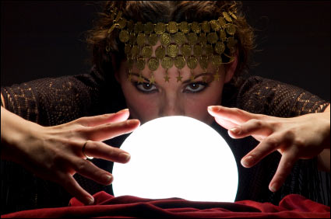
PREDICT
As you read the question, try to predict the sort of information that may be in the passage. It will help focus your mind.

Slide 32
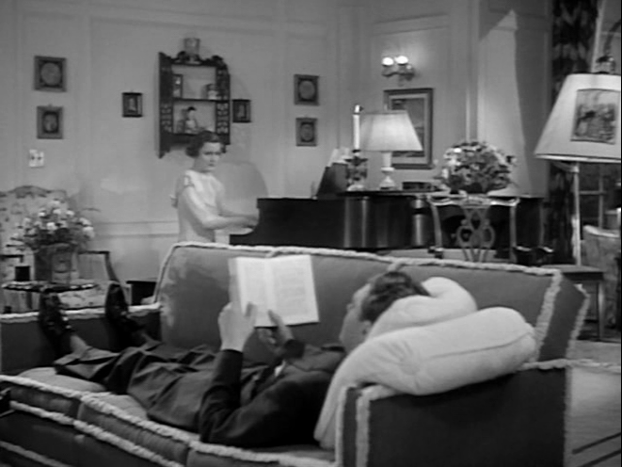
PREDICT
Anna is talking about
what she does in the
evening.
What words might you
expect to hear?

Slide 33
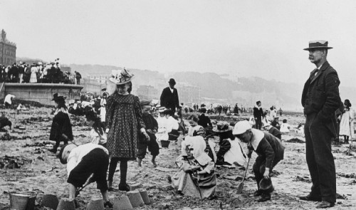
PREDICT
Juan talks about the
advantages and
disadvantages of holidays.
What things will he
talk about?

Slide 34
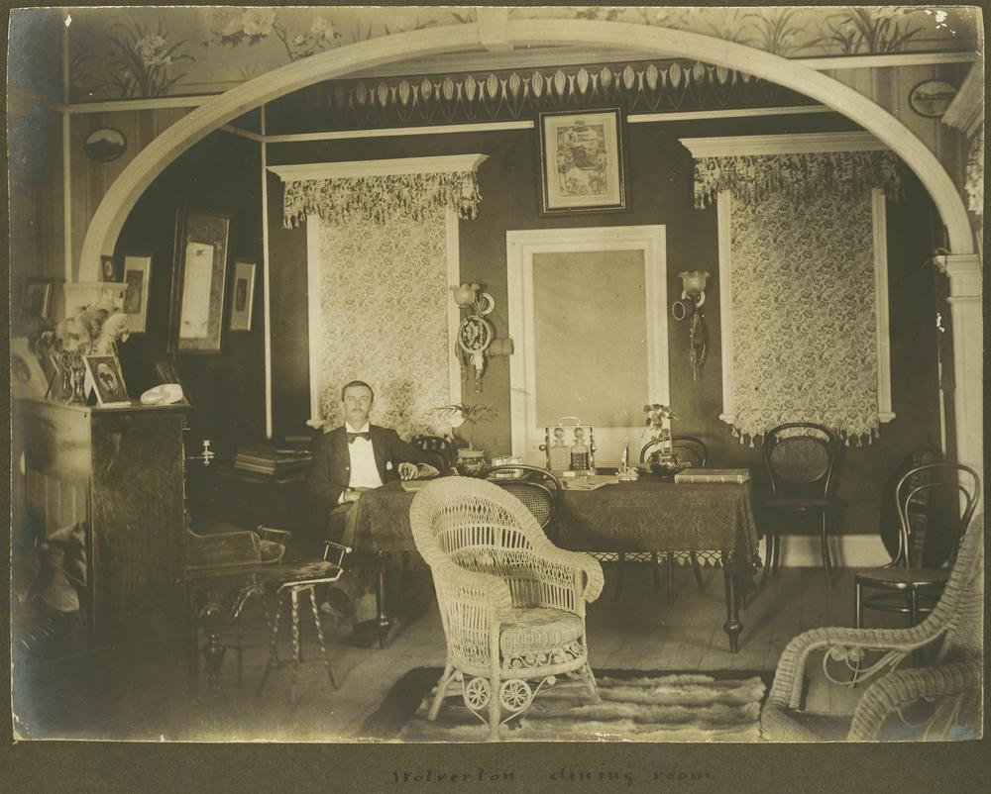
PREDICT
Marcos does NOT help out
at home.
What NEGATIVE words
might you expect to hear?

Slide 35
TOP TIP 2
BE POSITIVE

Slide 36

BE POSITIVE
Concentrate on what you do understand, not on the difficult words and phrases.
Use what you know to work out the meaning!

Slide 37
FILL the gap
http://www.donquijote.org/spanishlanguage/test/

Slide 38
FILL the gap
http://www.linguascope.com
linguatrivia

Slide 39
TOP TIP 3
THINK ABOUT IT

Slide 40
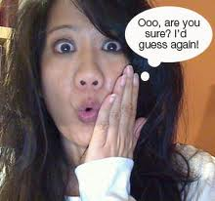

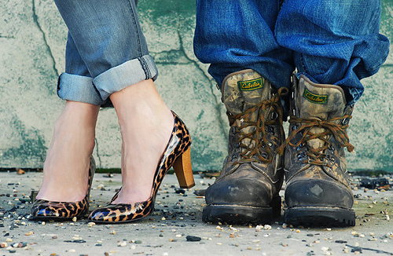
THINK ABOUT IT
FOCUS on making links with what you already know!

Slide 41
THINK ABOUT IT
Can you guess the meaning of a difficult word in a sentence if you understand what all the other words mean?

Slide 42

Complete the phrase...

Slide 43
COMPLETE the phrase...
1 | ¡Hasta la... | lista! | vista! | sista!
2 | ¿Quisieras bailar... | dondigo? | contigo? | conmigo?
3 | ¡Buena... | fuerte! | suerte! | muerte!
4 | ¡Que pase un buen… | tía! | ría! | día!
5 | Que te mejores... | pronto! | tonto! | levanto!
Notes:
This bar timer, will start when anywhere on the slide is clicked. The bar will move from left to right and the word ‘End’ will appear at the end, accompanied by a ‘Deep Gong’ sound. It is possible to change the duration of this timer to any time, by entering the animation settings, and changing the timing for ‘rectangle 3’. Note the time has to be entered as a number of seconds – so if you want 2mins & 30secs – this is entered as 150 (60X2 + 30 = 150).

Slide 44
COMPLETE the phrase...
1 | ¡Hasta la... | lista! | vista! | sista!
2 | ¿Quisieras bailar... | dondigo? | contigo? | conmigo?
3 | ¡Buena... | fuerte! | suerte! | muerte!
4 | ¡Que pase un buen… | tía! | ría! | día!
5 | Que te mejores... | pronto! | tonto! | levanto!
Notes:
This bar timer, will start when anywhere on the slide is clicked. The bar will move from left to right and the word ‘End’ will appear at the end, accompanied by a ‘Deep Gong’ sound. It is possible to change the duration of this timer to any time, by entering the animation settings, and changing the timing for ‘rectangle 3’. Note the time has to be entered as a number of seconds – so if you want 2mins & 30secs – this is entered as 150 (60X2 + 30 = 150).

Slide 45
COMPLETE the phrase...
1 | ¡Hasta la... | lista! | vista! | sista!
2 | ¿Quisieras bailar... | dondigo? | contigo? | conmigo?
3 | ¡Buena... | fuerte! | suerte! | muerte!
4 | ¡Que pase un buen… | tía! | ría! | día!
5 | Que te mejores... | pronto! | tonto! | levanto!
Notes:
This bar timer, will start when anywhere on the slide is clicked. The bar will move from left to right and the word ‘End’ will appear at the end, accompanied by a ‘Deep Gong’ sound. It is possible to change the duration of this timer to any time, by entering the animation settings, and changing the timing for ‘rectangle 3’. Note the time has to be entered as a number of seconds – so if you want 2mins & 30secs – this is entered as 150 (60X2 + 30 = 150).

Slide 46
COMPLETE the phrase...
1 | ¡Hasta la... | lista! | vista! | sista!
2 | ¿Quisieras bailar... | dondigo? | contigo? | conmigo?
3 | ¡Buena... | fuerte! | suerte! | muerte!
4 | ¡Que pase un buen… | tía! | ría! | día!
5 | Que te mejores... | pronto! | tonto! | levanto!
Notes:
This bar timer, will start when anywhere on the slide is clicked. The bar will move from left to right and the word ‘End’ will appear at the end, accompanied by a ‘Deep Gong’ sound. It is possible to change the duration of this timer to any time, by entering the animation settings, and changing the timing for ‘rectangle 3’. Note the time has to be entered as a number of seconds – so if you want 2mins & 30secs – this is entered as 150 (60X2 + 30 = 150).

Slide 47
COMPLETE the phrase...
1 | ¡Hasta la... | lista! | vista! | sista!
2 | ¿Quisieras bailar... | dondigo? | contigo? | conmigo?
3 | ¡Buena... | fuerte! | suerte! | muerte!
4 | ¡Que pase un buen… | tía! | ría! | día!
5 | Que te mejores... | pronto! | tonto! | levanto!
Notes:
This bar timer, will start when anywhere on the slide is clicked. The bar will move from left to right and the word ‘End’ will appear at the end, accompanied by a ‘Deep Gong’ sound. It is possible to change the duration of this timer to any time, by entering the animation settings, and changing the timing for ‘rectangle 3’. Note the time has to be entered as a number of seconds – so if you want 2mins & 30secs – this is entered as 150 (60X2 + 30 = 150).

Slide 48
COMPLETE the phrase...
1 | ¡Hasta la... | lista! | vista! | sista!
2 | ¿Quisieras bailar... | dondigo? | contigo? | conmigo?
3 | ¡Buena... | fuerte! | suerte! | muerte!
4 | ¡Que pase un buen… | tía! | ría! | día!
5 | Que te mejores... | pronto! | tonto! | levanto!
Notes:
This bar timer, will start when anywhere on the slide is clicked. The bar will move from left to right and the word ‘End’ will appear at the end, accompanied by a ‘Deep Gong’ sound. It is possible to change the duration of this timer to any time, by entering the animation settings, and changing the timing for ‘rectangle 3’. Note the time has to be entered as a number of seconds – so if you want 2mins & 30secs – this is entered as 150 (60X2 + 30 = 150).

Slide 49
COMPLETE THE PHRASE

Slide 50
1
Hoy hace mucho sol.
¿Por qué no vamos a la p______?
parque
perro
playa

Slide 51
2
Necesito sacar dinero.
¿Hay un b_______ cerca de aquí?
barco
banco
baño

Slide 52
3
Mi amigo vive en este edificio pero no sé si vive en la primera o segunda p_______.
planta
padre
pavo

Slide 53
4
En el centro de la ciudad hay
una i________ católica.
invierno
instituto
iglesia

Slide 54
5
Hay muchas ventajas de vivir en el c______.
No hay polución y no hay mucho tráfico.
campo
ciudad
comedor

Slide 55
6
El c________ en el Perú es muy bueno.
No llueve mucho y hace sol casí todos los días.
comida
clase
clima

Slide 56
THINK ABOUT IT
Can you find similarities between Spanish and English words?
(eg farmacia = chemist's / pharmacy)

Slide 57
5 cognates to try
atleta
dieta
guitarra
mapa
persona

Slide 58
5 cognates to try
favorito
minuto
mucho
rápido
tubo

Slide 59
5 cognates to try
diccionario
necesario
ordinario
salario
vocabulario

Slide 60
5 cognates to try
ciudad
comunidad
necesidad
universidad
velocidad

Slide 61
5 cognates to try
afortunadamente
especialmente
finalmente
generalmente
rapidamente

Slide 62
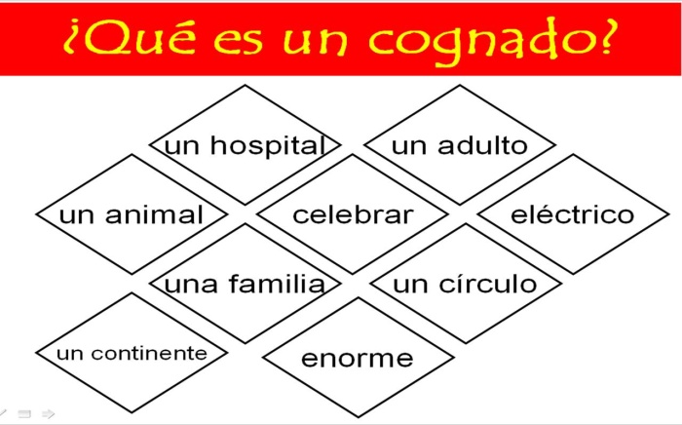
SUMMARY
What endings
do we see on
words in Spanish
which are cognates?

Slide 63
REVISE BY TOPIC

Slide 64
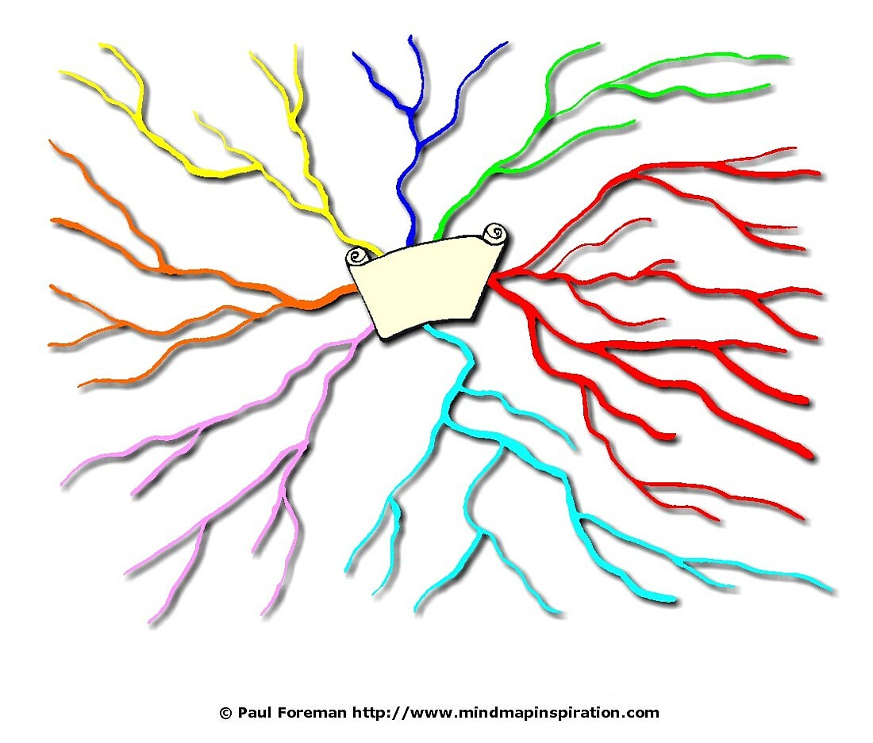
School/college and future plans

Slide 65
In the classroom – Quiz
http://www.atantot-extra.co.uk/resources/resource.php?l=es&r=afc368c2af790d9ba43b3be6e8bc8812

Slide 66
School
http://www.bbc.co.uk/schools/gcsebitesize/spanish/listeningh/1_h_list_school_rev1.shtml

Slide 67
Current and Future Jobs

Slide 68
Jobs
http://www.linguascope.com
Beginner
los empleos

Slide 69
Jobs
http://www.bbc.co.uk/schools/gcsebitesize/spanish/listeningf/5_f_list_jobs_rev1.shtml

Slide 70
Free Time and the Media

Slide 71
Leisure – Penalty
http://www.atantot-extra.co.uk/resources/resource.php?l=es&r=f450455a6ef657968eccc4d89b73e584

Slide 72
Freetime
http://www.bbc.co.uk/schools/gcsebitesize/spanish/listeningf/3_f_list_freetime_rev1.shtml

Slide 73
Holidays

Slide 74
Holidays – Listening
http://www.bbc.co.uk/schools/gcsebitesize/spanish/listeningf/2_f_list_holidays_rev1.shtml

Slide 75
Holidays – Reading
http://www.bbc.co.uk/schools/gcsebitesize/spanish/readingf/holidays/quiz/q41689363/

Slide 76
Home and Local Area

Slide 77
Home - Jigword
http://www.atantot-extra.co.uk/resources/resource.php?l=es&r=de57dec6b0a064b56cad21acd294b4a5

Slide 78
Reading 1
You want to go to the police station.
Which sign should you follow?
Plaza Mayor
Museo de Arte
Comisaría
Mercado

Slide 79
Reading 2
You want to get to the centre of town.
Which sign should you follow?
Castillo
Centro ciudad
Centro comercial
Catedral

Slide 80
Reading 3
You're at the station and you want to go to the ticket office. Which place should you go to?
Consigna
Sala de espera
Oficina de objectos perdidos
Despacho de billetes

Slide 81
Reading 4
You want to buy a roll.
Which shop should you go to?
Panadería
Pastelería
Verdulería
Pescadería

Slide 82
Reading 5
You want to buy a costume doll for your mother. Which of these signs in the shopping area should you follow?
Tienda de discos
Tienda de comestibles
Tienda de ropa
Tienda de recuerdos

Slide 83
Out and About – Listening
http://www.bbc.co.uk/schools/gcsebitesize/spanish/listeningf/4_f_list_outandabout_rev1.shtml

Slide 84
Environment

Slide 85
Weather – Grade
http://www.atantot-extra.co.uk/resources/resource.php?l=es&r=259f71f285320e53dea428c5f8694811

Slide 86
Environment
http://www.linguascope.com
Intermediate
Social Issues

Slide 87
Environment – Bananas
http://www.atantot-extra.co.uk/resources/resource.php?l=es&r=91ef5a571ac59c5d68546cc609d0e489

Slide 88
Relationship and Choices

Slide 89
Relationships
http://www.linguascope.com
Intermediate
Family and Friends

Slide 90
Family – O + X
http://www.atantot-extra.co.uk/resources/menu_resource.php?l=es&c=3&s=26

Slide 91



t_nt_
h_bl_d_r
p_r_z_s_
est_d_ _s_
s_r_ _
int_l_g_nte
g_n_r_s_
d_v_rt_d_
T_m_d_
ant_p_t_c_
c_nt_nt_
s_mp_t_c_
Notes:
Consonant game slide – mini plenary – post it note game.

Slide 92
tonto
hablador
perezoso
estudioso
s_r_ _
inteligente
generoso
divertido
T_m_d_
antipatico
contento
simpatico
Notes:
Consonant game slide – mini plenary – post it note game.

Slide 93
¿Puedes traducir las frases?
Me parezco a mi madre.
Alicia se lleva bien con su hermano, porque es paciente.
Me casé con Alberto en mil novecientos ochenta y nueve.
Mis padres se separaron en 2007.
Antes me llevaba bien con mi abuelo.

Slide 94
Food and Drink

Slide 95
Food – digital dialects
http://www.digitaldialects.com/Spanish/Food.htm

Slide 96
http://www.atantot-extra.co.uk/resources/menu_category.php?l=es&c=3
CHOOSE your game
Then play FOOD

Slide 97
Food and Drink
http://www.linguascope.com
Intermediate
Eating Out

Slide 98
Health

Slide 99
Health
http://www.linguascope.com
Intermediate
Healthy Eating

Slide 100
TOP 3 TIPS
REVISE and LEARN vocabulary
SHORT and REGULAR language practice
UNPICK the exam questions

Slide 101
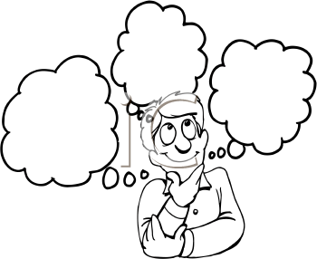
What have you learned today?

Slide 102
