Slide 1
Nouns
A quick lesson in word class

Slide 2
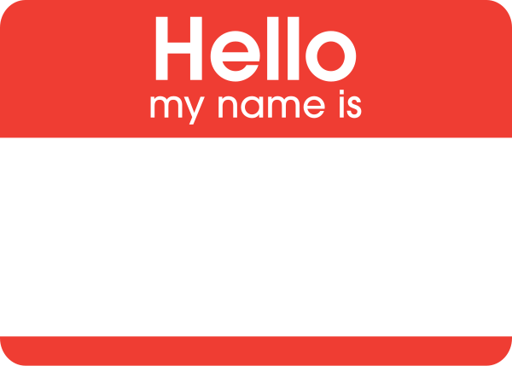
Nouns: What Are They?
‘Noun’ comes from the word ‘Nomen’, which means ‘name’.
So a noun is just the name of something.
The name of a person, place or thing.
Notes:
Image: https://commons.wikimedia.org/wiki/File:Hello_my_name_is_sticker.svg

Slide 3
Nouns: The Subject
Noun
Verb
Performed the action
Action
Jack ran.
Because Jack performs the verb, he is the subject of this sentence.
Top Tip: Don’t start so many of your sentences with the subject, especially with creative writing. Vary your sentence starters.

Slide 4
Nouns: The Object
Noun
Verb
Noun
Performed the action
Action
Receiving the action
Jack wrote a book.
Because the book receives the action, (it gets written), it is the object of the sentence.

Slide 5
Main Types of Nouns
Abstract Nouns
E.g.: My childhood was great.
Pronouns
E.g.: My childhood was great.
Proper Nouns
E.g.: My laptop was made by Lenovo.
Concrete Nouns
E.g.: Typing on the laptop is easy.
Collective Nouns
E.g.: The class was working hard.

Slide 6
Subject Terminology
Noun
Sophisticated Subject Terminology
Concrete Noun
Collective Noun
Pronoun
Abstract Noun
Proper Noun

Slide 7
Abstract Nouns
Pause the video and see if you can pick out the abstract nouns from the box.
These are things that can’t be experienced with the five senses.
Usually an idea, emotion, quality or a state.
E.g.: Happiness, luck, retirement, childhood.
TABLE
ME
ENGLAND
LILY
AWESOME
LOVE
MUSIC
OPINION
IT
FAMILY
HERD
PACK
PENCIL
GOOGLE
FLOWER
TRUTH
JEALOUSY
AWESOMENESS
YOU
TIME
CLOCK
SHARON
INTELLIGENCE
FIRE
FIREFIGHTER
RECTANGLE

Slide 8
Task
Can you identify and label the different abstract nouns in the extract from Stevenson’s ‘Treasure Island’ below?
I remember him as if it were yesterday, as he came plodding to the inn door, his sea-chest following behind him in a hand-barrow—a tall, strong, heavy, nut-brown man, his tarry pigtail falling over the shoulder of his soiled blue coat, his hands ragged and scarred, with black, broken nails, and the sabre cut across one cheek, a dirty, livid white. I remember him looking round the cover and whistling to himself as he did so, and then breaking out in that old sea-song that he sang so often afterwards:
“Fifteen men on the dead man's chest—
Yo-ho-ho, and a bottle of rum!”
in the high, old tottering voice that seemed to have been tuned and broken at the capstan bars. Then he rapped on the door with a bit of stick like a handspike that he carried, and when my father appeared, called roughly for a glass of rum. This, when it was brought to him, he drank slowly, like a connoisseur, lingering on the taste and still looking about him at the cliffs and up at our signboard.
“This is a handy cove,” says he at length; “and a pleasant sittyated grog-shop. Much company, mate?”
My father told him no, very little company, the more was the pity.
“Well, then,” said he, “this is the berth for me. Here you, matey,” he cried to the man who trundled the barrow; “bring up alongside and help up my chest. I'll stay here a bit,” he continued. “I'm a plain man; rum and bacon and eggs is what I want, and that head up there for to watch ships off. What you mought call me? You mought call me captain. Oh, I see what you're at—there”; and he threw down three or four gold pieces on the threshold. “You can tell me when I've worked through that,” says he, looking as fierce as a commander.

