Slide 1
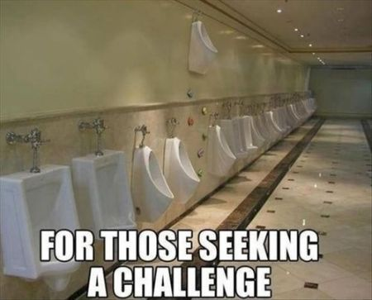

Slide 2
Aims of session
Aims of the session

Slide 3
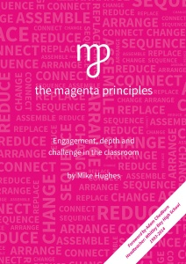

Slide 5
Learning is the consequence of thinking… therefore our job is to get them to think
Language is central to thinking… therefore our job is to get them to talk
Learning is an active process… therefore our job is to get them doing

Slide 6
“If our goal was to make learning an engaging, student centred experience then the Magenta Principles was the vehicle that enabled us to get there.”

Slide 7
What are the Magenta Principles?

Slide 8
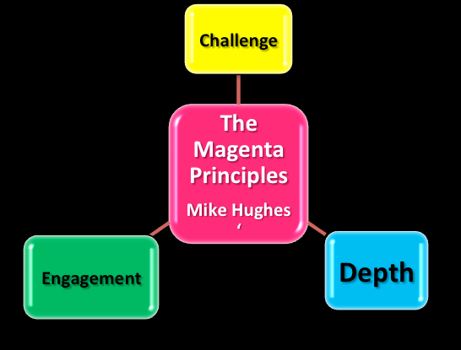

Slide 9
The Magenta PrinciplesTM
Magenta Principles?
One principle; in order to make sense of the information that comes their way, children have to do something to / with it.
We want them to get it, get why they got it and, as much as anything, enjoy it ☺

Slide 10
What are the Magenta Principles we can use in the classroom?

Slide 11
Magenta Principles?
Connect
Contrast
Arrange
Challenge
Replace
Reduce
Change
Develop
Deconstruct
Prioritise

Slide 12
Connect transfers of knowledge, mind maps, linking ideas together, describe how different topics are linked together appendices of information – link together and explain links! Contrast for/against, positive/negative, analyse method differences, debating, introduce an idea, is it this or that: vocab. Compare sources, opinions for/against

Slide 13
Arrange
- Diamond 9, venn diagram, different graph layouts, human sentence, story line, sort, pick out sentances, for/against, timeline, classify
Challenge
Should be omnipresent in every task
Teach a lesson, re-draft, open ended questions, passing questions around the class

Slide 14
Replace
Can you answer the question without using the word….
Replace words with pictures/actions
Replace certain words with different words that might mean the same thing
Reduce
What are the 3 key words? 5 suprising things in a text. Staged reduction

Slide 15
Change
Bar chart: change to a different form
Story into timeline
Change words to pictures and de-code to partners (and vice versa) clarify a piece of work. Paraphrase.
Develop
Connectives in A-level – used two, now use three to extend. Trap door game
Take something and make it better using awesome words/increasing detail. Re drafting
Give word and develop into sentence/idea

Slide 16
Deconstruct
Break down a task into a mini task
Take apart exam question
Text attack (with a highlighter)
Prioritise
Diamond 9
Identifying which part of a task needs to be done first

Slide 17
Tailoring MP to G&T
Tweaking MP for G&T

Slide 18
What would you expect a G&T student to be like?

Slide 19
Gifted students need to serve as examples to others, and they should always assume extra responsibility.
Gifted students are naturally creative and do not need encouragement.
Gifted students do not need help. If they are really gifted, they can manage on their own.
The social & emotional development of the gifted student is at the same level as his/her intellectual development.
The primary value of a gifted student lies in their brain power.

Slide 20
Common myths
Gifted students need to serve as examples to others, and they should always assume extra responsibility.
Gifted students are naturally creative and do not need encouragement.
Gifted students do not need help. If they are really gifted, they can manage on their own.
The social & emotional development of the gifted student is at the same level as his/her intellectual development.
The primary value of a gifted student lies in their brain power.

Slide 21
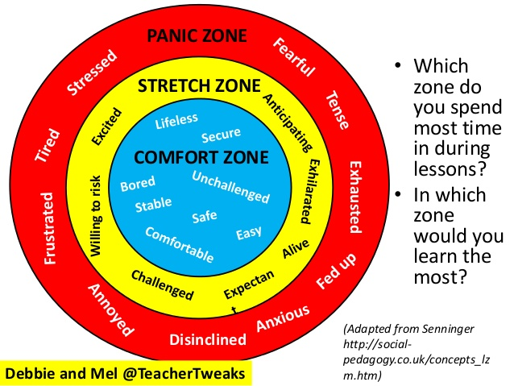

Slide 22
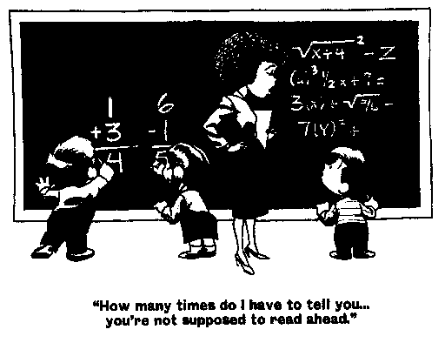

Slide 23
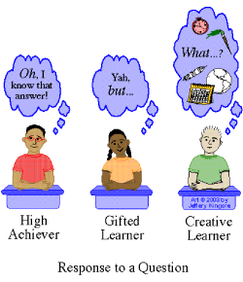

Slide 24
What do you think the question was?
“the teacher just makes it up”
“never gets marked”
“don’t get enough time to finish it”
“why should I do more work when I have already worked hard”

Slide 26
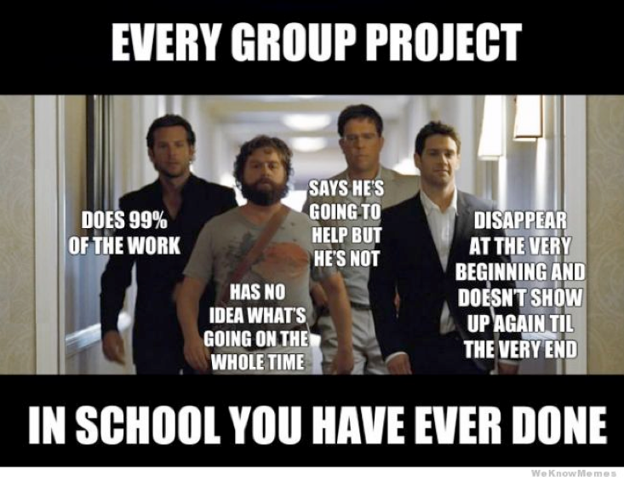
Group work with G&T
Group work with G&T

Slide 27
Perfect magenta task!
Perfect magenta task!

Slide 28
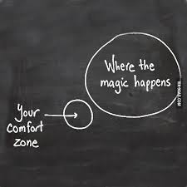

Slide 29
Vegetable oils do not dissolve in water. If oil and water are shaken together, tiny droplets of one liquid spread through the other liquid, forming a mixture called an emulsion.
If an emulsion is left to stand, eventually a layer of oil will form on the surface of the water. Emulsifiers are substances that stabilise emulsions, stopping them separating out. Egg yolk contains a natural emulsifier. Mayonnaise is a stable emulsion of vegetable oil and vinegar with egg yolk.

Slide 30
Mimes/role play/creating a story
Ideas with how to stretch it:
- One pupil narration
Picking a question for the group performing
Asking pupils which mime was the most detailed/clear/educational with reasons why
Not allowing them to use the key words they’ve picked
Adding something to add extra detail/excitement

Slide 31
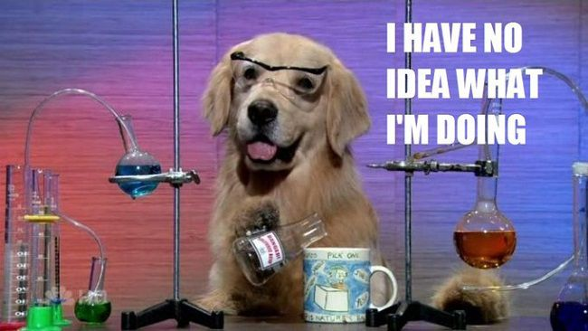
We’re going to have a quick go!

Slide 32
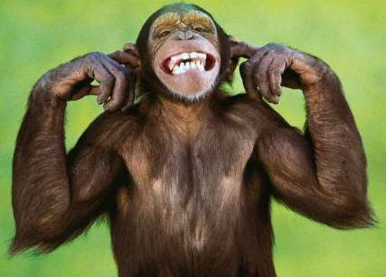
Seven Monkeys
This activity works on the principle that different students learn in different ways (V, A, K etc).
This will enable you to answer your exam questions in the second half of the lesson.

Slide 33
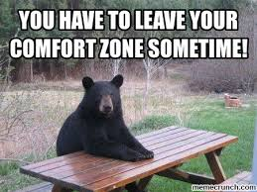

Slide 34
for listening ☺

