Slide 1
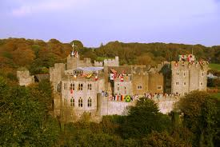
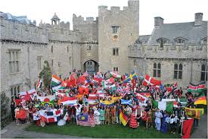
Peace Conference and Model United Nations Thursday 28th and Friday 29th January 2015
We can bring a small number of students. Please apply by writing 100 words on how you would benefit from coming and how it would benefit The Studio by taking you. You must give or email this to me by 9th January 2015.

